Slide 1
Differential WBC count

Slide 2
Principle
A blood film is stained with Leishman’s stain and scanned under oil immersion, from one end to the other.
As each WBC is encountered, it is identified until 200 leukocytes have been examined.
The percentage distribution of each type of WBC is then calculated.

Slide 3
Leukocytes
Leukocytes are divided into two groups according to the type of cytoplasmic granules & the shape of their nuclei:
Polymorphonuclear granulocytes
Mononuclear agranulocytes

Slide 5
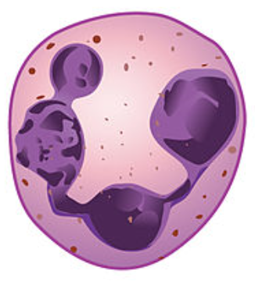
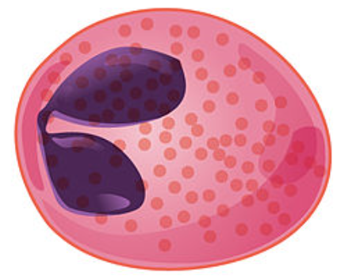
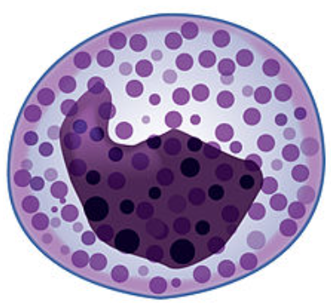
Granular leukocytes
Neutrophil | Eosinophil | Basophil
40–70% of circulating WBCs | 1–6% of circulating WBCs | <1% of circulating WBCs
Cytoplasmic granules are fine & stained violet pink | Cytoplasmic granules are coarse & stained red | Cytoplasmic granules are coarse & stained dark blue
Nucleus with 3-5 lobes | Bi-lobed nucleus | S-shaped nucleus

Slide 6
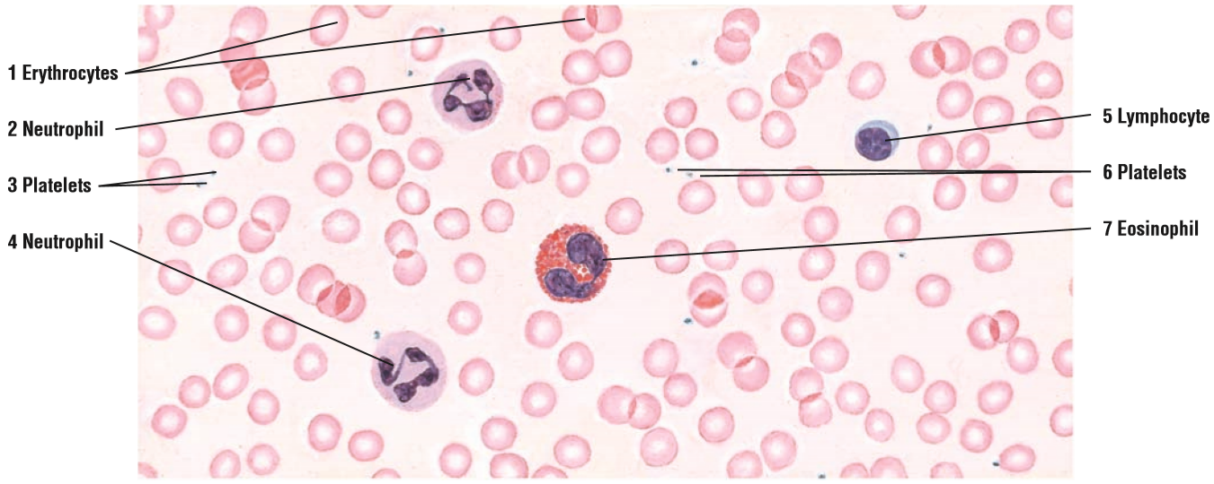

Slide 7
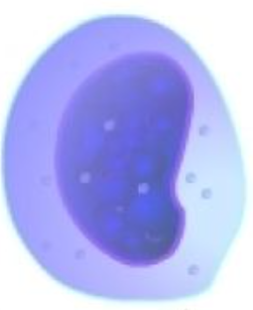
Agranular leukocytes
Lymphocytes | Monocytes
20–40% of circulating WBCs | 5–10% of circulating WBCs
Spherical cell, thin crescent of clear, light blue cytoplasm | Large spherical cells, abundant cytoplasm stains gray-blue
Large, round nucleus, almost fills cell | Large U-shaped or kidney shaped nucleus

Slide 8
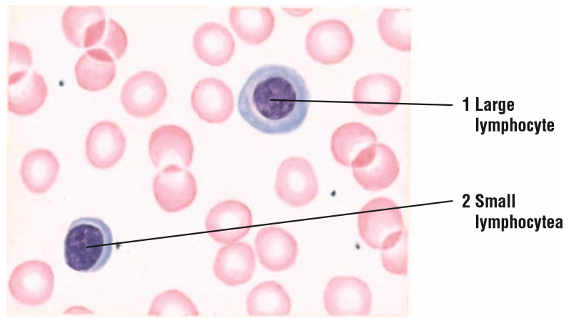

Slide 9
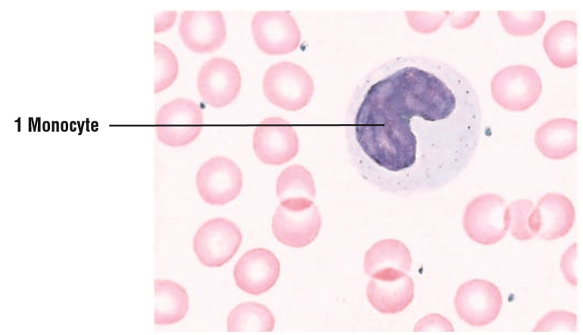

Slide 10
Granular leukocytes
Neutrophil | Eosinophil | Basophil
40–70% of circulating WBCs | 1–6% of circulating WBCs | <1% of circulating WBCs
Cytoplasmic granules are fine & stained violet pink, nucleus with 3-5 lobes | Cytoplasmic granules are coarse & stained red, bi-lobed nucleus | Cytoplasmic granules are coarse & stained dark blue with hematoxylin, S-shaped nucleus
Phagocytose bacteria and debris | Secrete proteins cytotoxic to parasites, neutralize histamine & phagocytose Ag-Ab complexes | participate in the hypersensitivity reaction by secreting histamine and heparin

Slide 11
Agranular leukocytes
Lymphocytes | Monocytes
20–40% of circulating WBCs | 5–10% of circulating WBCs
Spherical cell, scant cytoplasm and a round heterochromatic nucleus often with a small indentation | Large spherical cells, abundant cytoplasm stains gray-blue, large U-shaped nucleus
Have diverse functional roles related to immune defense against invading microorganism, foreign antigen & cancer cells | Circulating monocytes are precursor cells of the mononuclear phagocyte system, function in phagocytosis and antigen presentation

Slide 12
Apparatus and materials
Microscope
Clean glass slides, sterile lancet, cotton and gauze swabs, & 70% alcohol
A drop bottle containing Leishman’s stain
A wash bottle of disLeishman’s staintilled water

Slide 13
Apparatus and materials
Leishman’s stain
It contains a compound dye ’’eosinate of methylene-blue’’ dissolved in acetone-free methyl alcohol.
Eosin; It is an acidic dye and stains basic granules in the cytoplasm a red color (eosinophil).
Methylene-blue; It is a basic dye and stains acidic granules in the cytoplasm a blue-violet. Color (basophil).

Slide 14
Steps in differential WBC count
Preparing the blood films.
Examining the blood smears and choosing the ideal films for staining.
Fixing and staining the blood films.
Identification and counting of various leukocytes.

Slide 15
Preparing the blood films
Place 3 or 4 slides on a white sheet of paper on your work-table.
Allow a medium-sized drop of blood to form on the finger-tip.
Steady the pricked finger. Lift a slide from the table, holding it along its long edges. Then touch its center to the blood drop.

Slide 16
Preparing the blood films
Place the slide with the blood drop flat on the table. Now grasp the long edges of a second slide, the “spreader”, between thumb and fingers.
Place the narrow edge of the spreader on the first slide, at an angle of 40°, just in front of the blood drop.

Slide 17
Preparing the blood films

Slide 18
Preparing the blood films

Slide 19
Preparing the blood films
Steady the first slide, and maintaining a light but even pressure and 40° angle, move the spreader forwards in a single, smooth, fairly fast motion, pulling the blood behind it in the form of a thin smear.

Slide 20
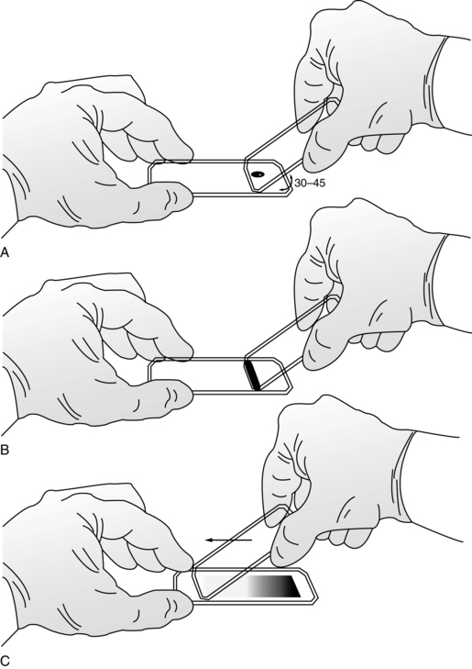

Slide 21
Preparing the blood films
Make as many trials as possible to get acceptable films, keeping in mind the features of an ideal blood smear.
Dry the film by waving the slide in the air (Do not try to blot-dry the film).

Slide 22
Features of an ideal blood film
The blood film should occupy the middle two-thirds of the slide.
It should be tongue-shaped, (broad at the head and taper towards the other end, but without any ‘tails’).
It should be translucent, with no vacant areas, striations, or ‘granular’ areas.

Slide 23
Features of an ideal blood film
Head
Body
Tail

Slide 24
Features of an ideal blood film
It should be neither very thick nor very thin. A thin film looks faintly pink against a white surface, while a thick smear appears red.
The red cells, as seen under the microscope, should lie separately from each other without any crowding.

Slide 25
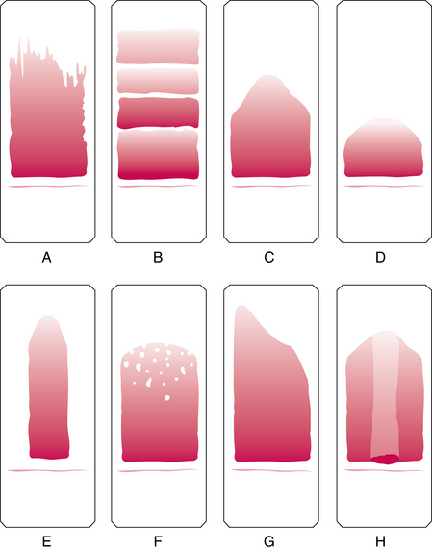

Slide 26
Fixing & Staining of blood films
Fixation: is the process that makes the blood film adhere to the glass slide. It also preserves the shape and chemistry of cells as near living cells as possible.
Staining: is the process that stains (colors) the nuclei and cytoplasm of the cells.
Both these purposes are achieved by the Leishman’s stain.

Slide 27
Fixing & Staining of blood films
Place the slides, on a ‘staining rack’ assembled over a sink. Ensure that they are horizontal.
Pour 8–10 drops of the stain on each slide by dripping it from a drop bottle, This amount of stain usually covers the entire surface. Note the time.

Slide 29
Fixing & Staining of blood films
Allow the stain to remain undisturbed for 1–2 minutes, as advised.
Watch the stain carefully, and see that it does not become syrupy (thick) due to evaporation of alcohol.
If the stain dries, it will precipitate on the blood film and appear as round, blue granules. This can be prevented by pouring more stain on the slides as required.

Slide 30
Fixing & Staining of blood films
Add an equal number of drops of distilled water to the stain.
Mix the stain and water by gently blowing at different places on the slides through a dropper, without scratching the smear. Allow the stain to remain on the slide for 6–8 minutes.
Notes:
If the water is carefully dripped from a dropper, the entire mixture will stand up from the edges of the slides (due to surface tension) without spilling over.

Slide 31
Fixing & Staining of blood films
Flush off the diluted stain in a gentle stream of distilled water for about 30 seconds and leave the slides for about a minute with the last wash of water covering them.
Drain the slides and put them in an inclined position against a support, stained sides facing downwards (to prevent dust particles settling on them) to drain and dry.

Slide 32
Fixing & Staining of blood films

Slide 33
Assessment of stained blood smears
Take an assessment of all the blood films. Examine with naked eye first, and then under LP & HP. Choose the best stained films for counting.
Make sure that you can identify all the leukocytes with certainty.

Slide 34
Assessment of stained blood smears
Ensure that you are examining the blood smear side of the slide.
Hold the slide in bright light and tilt it this way and that to see if there are any reflections.
The clean side shows reflections, while the side which has the blood smear appears dull and does not show any reflections.

Slide 35
Features of a well-stained blood smear
Naked eye appearance
The smear appears translucent and bluish-pink when seen against a white surface, its thickness being uniform throughout.
It is assumed that an ideal blood film has been stained.

Slide 36
Features of a well-stained blood smear
Under low magnifications
The red cells appear as dots. The WBCs cannot be differentiated.
Under high magnification
The red cells are stained pink. The WBCs can be differentiated laying unevenly among the red cells.

Slide 37
Staining defects
The staining defects include:
Precipitation of stain particles
Over staining
Under staining
Notes:
Presence of stain granules. Occasionally, round, solid-looking, deep blue-violet particles of stain get precipitated all over a blood film. They appear if the Leishman’s stain is old, or if it has not been properly filtered, or if it was allowed to dry up on the slide during fixing. Finally, it may be due to insufficient washing of the greenish metallic scum that forms on the stain-water mixture during staining.
2. Excessively blue appearance. The RBCs appear deep blue or even bluish-black. The nuclei of WBCs are stained dark blue, with bluish cytoplasm in all cells; the PMNs cannot be differentiated. This appearance may be due to over-staining, over- fixing, insufficient washing or the use of alkaline stain or water. It can be corrected by reducing the fixing and staining times, and proper washing under running water.
3. Excessively reddish appearance. In this case the red cells appear pale pink. The WBCs show pale blue cytoplasm, while the nuclei typically appear lighter than the cytoplasm, or even colorless. This appearance may be due to understaining, over- washing or the use of more acidic stain or water. The defect may be rectified by re-staining, if required.
4. Faded appearance of blood cells. This may result from the use of old stain, under-staining, or over-washing.

Slide 38
Observations and results
Place 2 drops of cedar wood oil in the center of the smear.
Bring the oil-immersion lens into position and focus the cells.
Examine the slide all over by using ’’the battlement technique’’.
Identify and count each leukocyte, as you encounter it.
Express your results in (%) for each type of cell.

Slide 39
Differential counting of leukocyte
Draw 5 columns in your workbook for recording various WBCs as they are encountered and identified one after another.
Put a short vertical stroke against each cell identified.
Enter these cells by using the letters ‘N’ for neutrophils, ‘E’ for eosinophils, and ‘B’ for basophils, ‘M’ for monocytes, & ‘L’ for lymphocytes.

Slide 40
Differential counting of leukocyte
Use the battlement technique as follows:
Move the slide to the right and as you encounter a leukocyte, identify it, and enter it in your workbook.
As you approach the end of the smear, move 2 fields down and scan the film in the opposite direction.
As you near the head, again move 2 fields down and scan the film towards the tail.
Continue until 200 cells have been counted.
Notes:
This “battlement” procedure, ensures that you do not count a leukocyte more than once.

Slide 41
Head
Body
Tail
Technique for differential count
(Battlement technique)

Slide 42
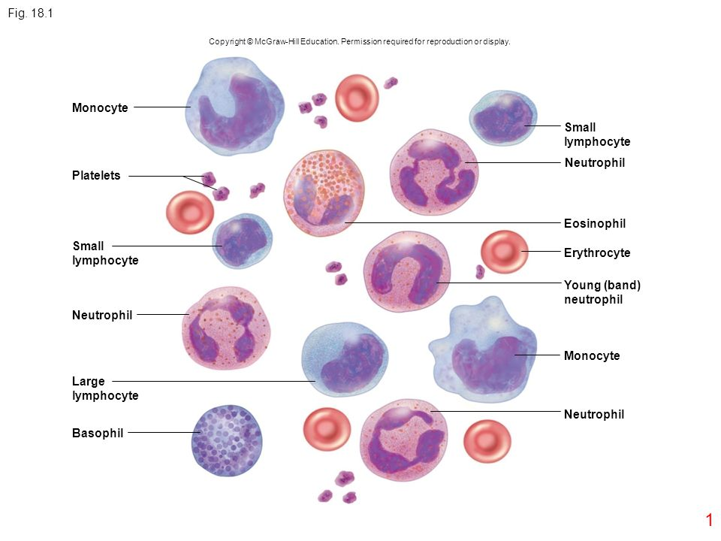

Slide 43
Differential counting of leukocyte
When counting has been done, express your results in (%) for each type of cell.
The neutrophils are the prominent cells of the blood and constitute about 40-70% of the WBCs.
The next predominant cells are lymphocytes (20–40%), which may be small or large.
The third cell in the order of population is the monocyte which constitutes 5–10% of the WBCs.

Slide 44
PRECAUTIONS
The slides should be absolutely free from dust and grease, because blood will not stick to areas where oils from your fingers have been left. New slides should be preferred.

Slide 45
PRECAUTIONS
The edge of the spreader should be smooth and not chipped, otherwise the slide would leave striations along or across the smear. Leukocytes may also be caught in chipped places and be carried towards the tail.

Slide 46
PRECAUTIONS
When applying the slide to the blood drop from a finger-prick, do not touch the skin with the slide, but only the periphery of the blood drop.
This is to avoid taking up epidermal squames or sweat.

Slide 47
PRECAUTIONS
The Leishman stain should be kept in well stoppered bottles to keep out air from the solution.
When counting the cells, avoid the extreme ends of the head or tail, and along the edges of the blood film.

